Slide 1







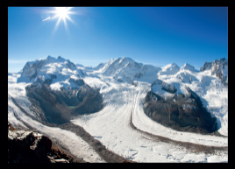
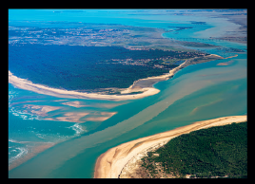
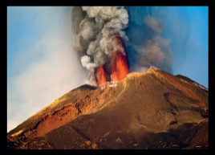


Thermal Remote Sensing Workshop
and LST_cci User Workshop 2024
Leicester, UK – Dec 2-4, 2024
The Indo-French TRISHNA mission
Monitoring our ecosystems from space
Philippe Gamet (CNES), Bimal K. Bhattacharya (SAC), Jean-Louis Roujean (CESBIO), Gilles Boulet (IRD), Emmanuelle Autret (IFREMER), Ghislain Picard (IGE), Laure Roupioz (ONERA), Mark Irvine (INRAE), Sébastien Marcq (CNES), Corinne Salcedo (CNES), Philippe Maisongrande (CNES)

Slide 2
Outline
The water issue
TRISHNA mission design
Evapotranspiration

Slide 3









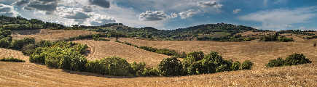
The water issue
~+2 billions people by 2050
Pressure ↗ on energy and food
Pressure ↗ on transboundary basins
Population ↗ in fluvial & coastal zones
Biodiversity / pressure on the habitat
In Rivers, wetlands, coastal zones
Modified by dams (connectivity),
pollution (health)
Global warming +2deg by 2050
Impact on Carbon and water cycles
Extreme events: droughts, floods,
storms, fires
Essential Agricultural Variables
→ meet current and evolving policy drivers for agriculture
Adaptation, mitigation Stakes
involving Science and Application levels in Economy, ecology, geopolitics, security…
Reliable metrics needed, homogeneous along time and on every scale from global to regional

Slide 4
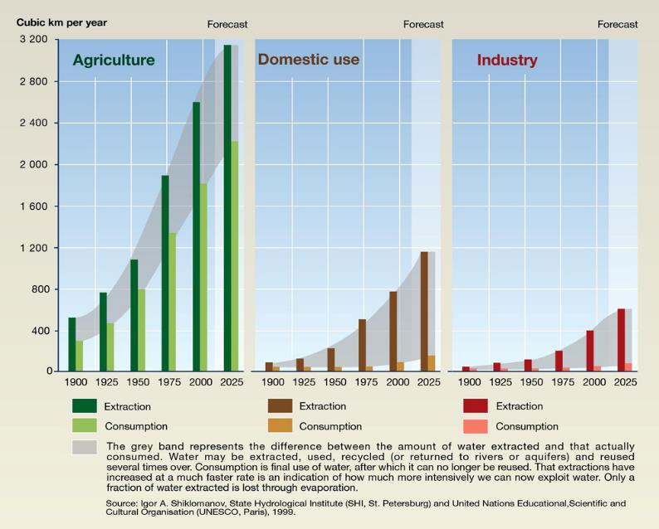
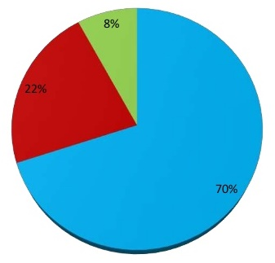
The water issue
Increasing scarcity and deteriorating quality of the water resource
70% of World water use is for agriculture
!
Rapid increase of water consumption
World water use
Agriculture
Industry
Towns and municipalities
Source: World Bank, World Development Indicators, 2012
Trends in water use by sector (UNEP)
(http://www.unep.org/dewa/vitalwater/article43.html)

Slide 5
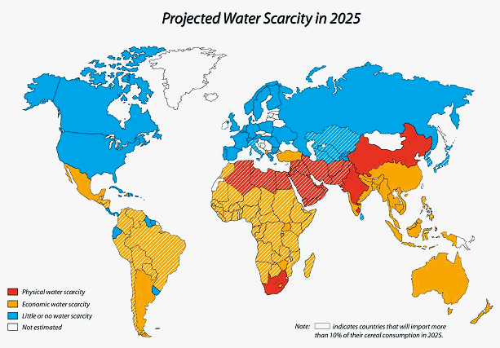
The water issue
Check also: https://www.un.org/waterforlifedecade/scarcity.shtml
Source: FAO

Slide 6
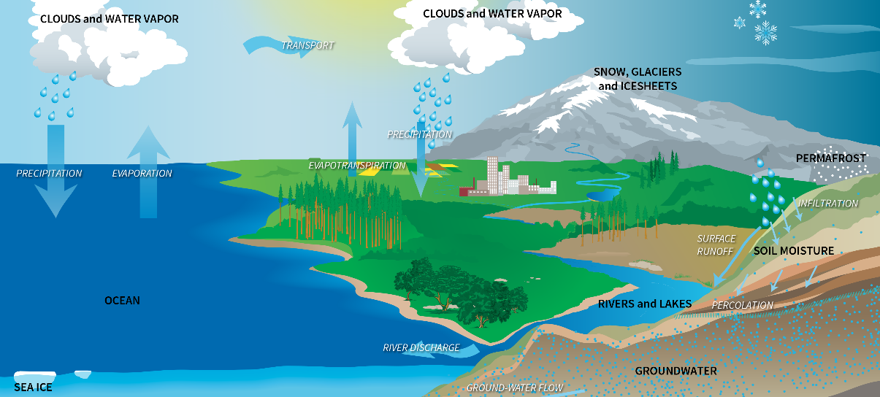
Water cycle

Slide 7






Water cycle
P
E
Q
$$\frac{{dS}_{SM}}{dt}$$
+
$$\frac{{dS}_{SW}}{dt}$$
+
$$\frac{{dS}_{GW}}{dt}$$
=
-
-
Water Storage
Soil Moisture
Surface Water
Ground Water
Precipitation
EvapoTranspiration
Run-off

Slide 8

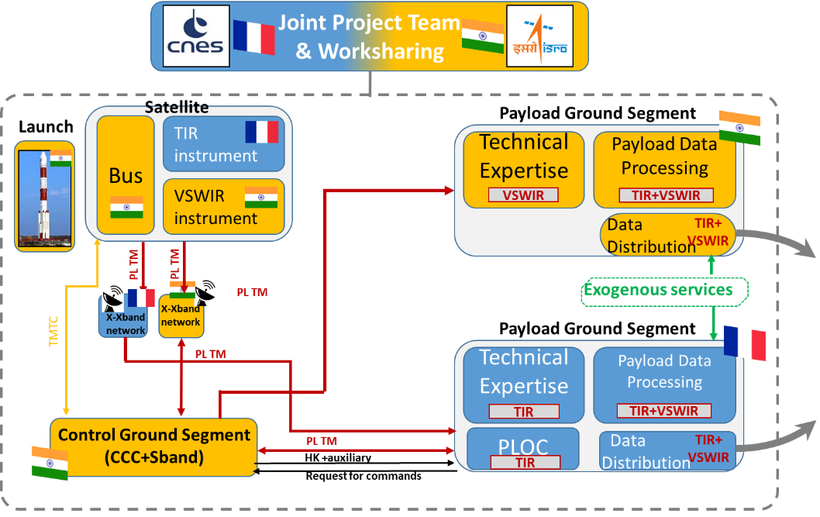
TRISHNA Mission design
ISRO/CNES cooperation, launch 2026
5-year lifetime

Slide 9
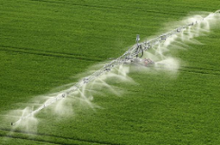
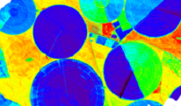
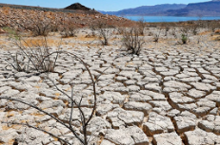
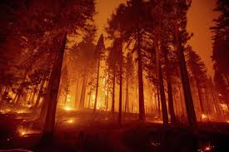

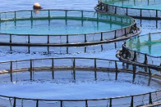
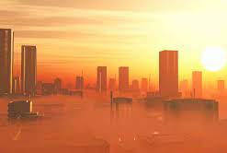
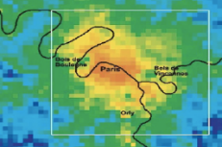
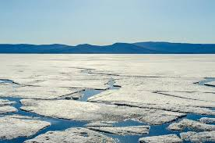
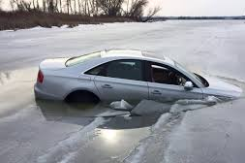
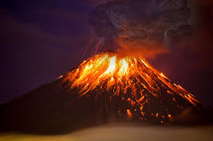
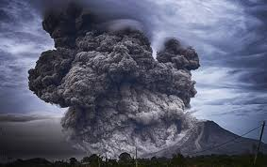
TRISHNA Mission design
ISRO/CNES cooperation, launch 2026
5-year lifetime
Design drivers: ecosystem stress and water use; coastal & inland waters
Water mgmt, agriculture
Ecosystem health, drought, fire
Coastal and inland waters
Urban heat
Cryosphere
Solid Earth

Slide 10
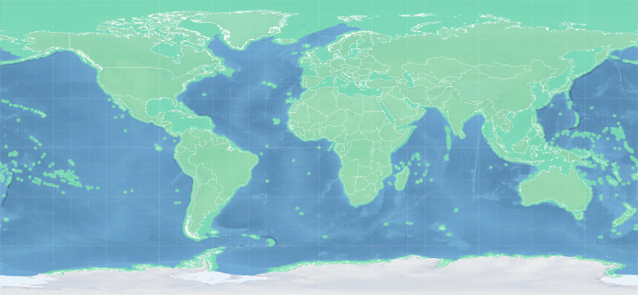
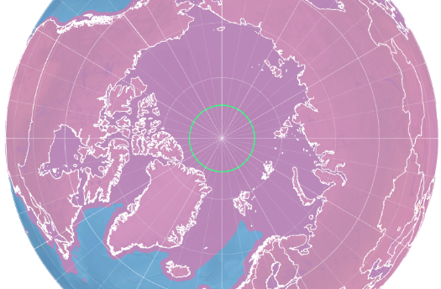
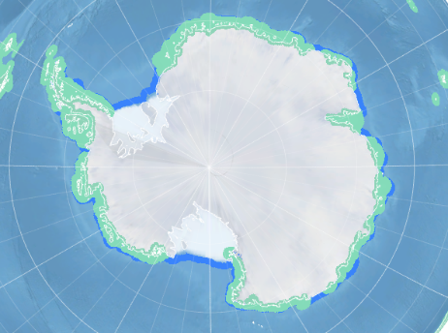
TRISHNA Mission design
ISRO/CNES cooperation, launch 2026
5-year lifetime
Design drivers: ecosystem stress and water use; coastal & inland waters
Global coverage land + coastal
Global coverage land + coastal
  Continental surfaces
  Coastal areas 100 km from the coastline
  Coastal waters with bathymetry < 250m
  Closed seas + Mediterranean Sea
  Antarctica coastline

Slide 11
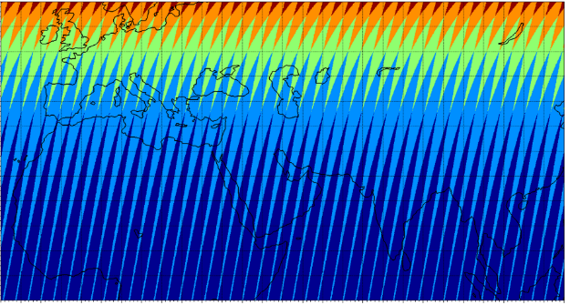
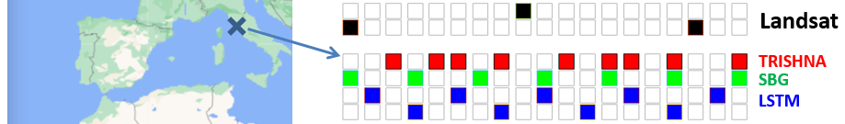

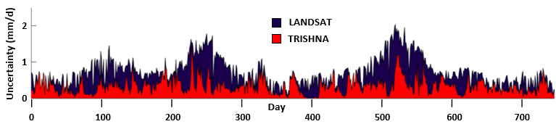
TRISHNA Mission overview
TRISHNA Mission design
ISRO/CNES cooperation, launch 2026
5-year lifetime
Design drivers: ecosystem stress and water use; coastal & inland waters
Global coverage land + coastal
3-day revisit
Global coverage land + coastal
Typical temporal pattern of acquisitions over Grosseto for LANDSAT, TRISHNA, LSTM and SBG
Courtesy of Albert Olioso
Uncertainty on Daily Evapotranspiration induced by interpolation - Sunflower crops in Grosseto over 2 years
Average revisit (in days)

Slide 12
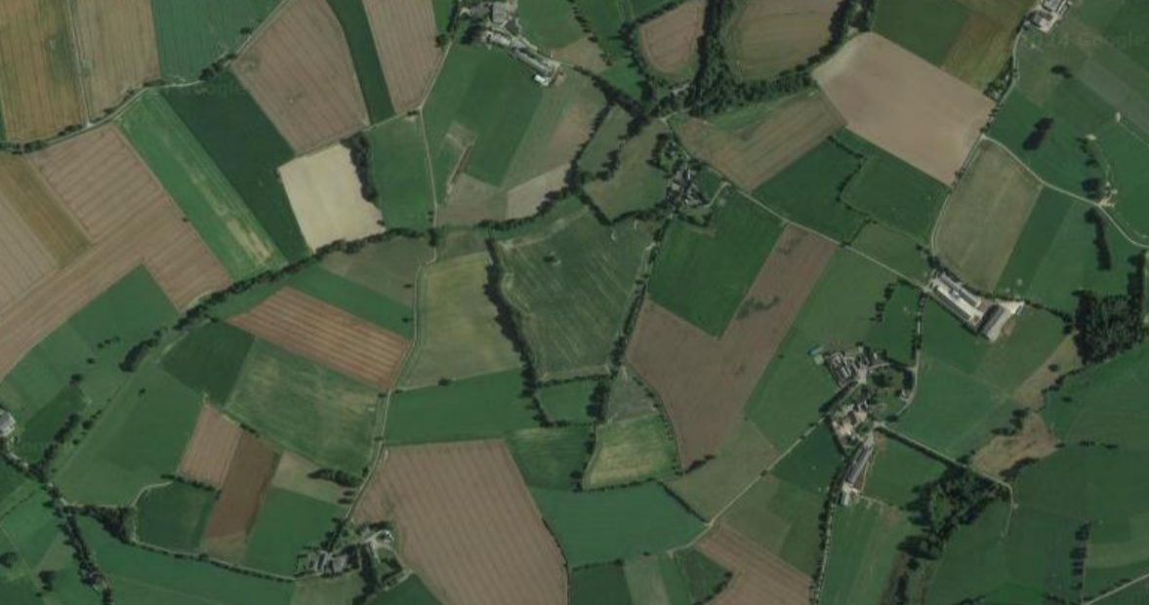
TRISHNA Mission overview
TRISHNA Mission design
ISRO/CNES cooperation, launch 2026
5-year lifetime
Design drivers: ecosystem stress and water use; coastal & inland waters
Global coverage land + coastal
3-day revisit, 60m ground resolution
Global coverage land + coastal
60 m
Average revisit (in days)
TRISHNA ground sampling over a typical agriculture landscape in French Brittany

Slide 13
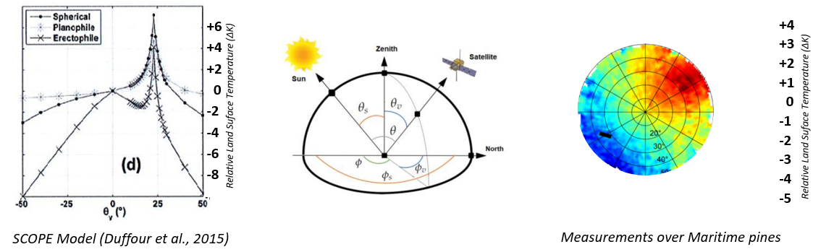

TRISHNA Mission overview
TRISHNA Mission design
ISRO/CNES cooperation, launch 2026
5-year lifetime
Design drivers: ecosystem stress and water use; coastal & inland waters
Global coverage land + coastal
3-day revisit, 60m ground resolution
Different observation angles, up to 38 deg
Global coverage land + coastal
Average revisit (in days)

Slide 14
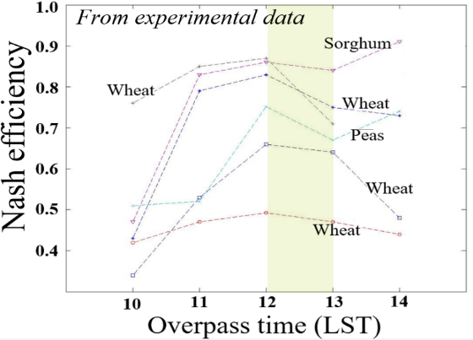
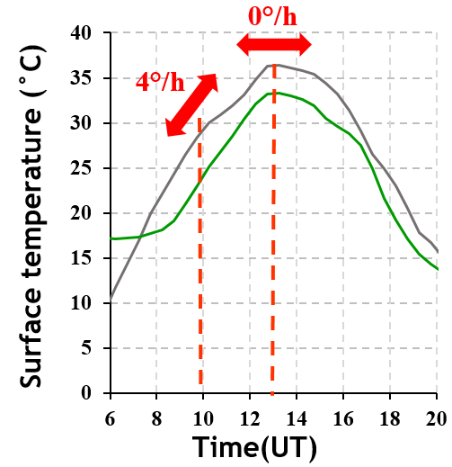
TRISHNA Mission overview
TRISHNA Mission design
ISRO/CNES cooperation, launch 2026
5-year lifetime
Design drivers: ecosystem stress and water use; coastal & inland waters
Global coverage land + coastal
3-day revisit, 60m ground resolution
Different observation angles, up to 38 deg
Overpass time : 12:30 PM & AM at Equator
Global coverage land + coastal
Overpass time must cope with max sensitivity for flux estimation
Minimizing the sensitivity of LST measurement to overpass time
Average revisit (in days)
→ 1PM LST more suited to models with 30mn-1h time steps
→ 1PM LST minimizes impact of time differences (orbit)
Noon to 1PM LST → max accuracy on fluxes retrieval

Slide 15

TRISHNA Mission overview
TRISHNA Mission design
ISRO/CNES cooperation, launch 2026
5-year lifetime
Design drivers: ecosystem stress and water use; coastal & inland waters
Global coverage land + coastal
3-day revisit, 60m ground resolution
Different observation angles, up to 38 deg
Overpass time : 12:30 PM & AM at Equator
VNIR-SWIR (7 bands) – LWIR (4 bands)
NeDT 0.2K at instrument output, AKA 0.5K
Global coverage land + coastal
Average revisit (in days)
Spectral bands
0.5µm 0.6 0.7 0.8 0.9 1µm 1.1 1.2 1.3 1.4 1.5µm 1.6
8µm 9µm 10µm 11µm 12µm

Slide 16
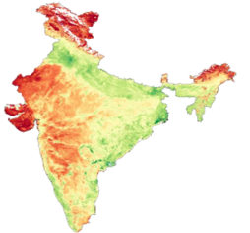
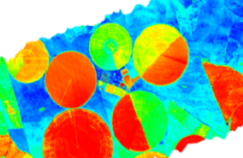
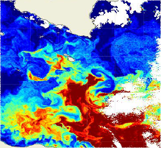
TRISHNA Mission overview
TRISHNA Mission design
ISRO/CNES cooperation, launch 2026
5-year lifetime
Design drivers: ecosystem stress and water use; coastal & inland waters
Global coverage land + coastal
3-day revisit, 60m ground resolution
Different observation angles, up to 38 deg
Overpass time : 12:30 PM & AM at Equator
VNIR-SWIR (7 bands) – LWIR (4 bands)
NeDT 0.2K at instrument output, AKA 0.5K
Free & open data policy
Level 1: top-of atm reflectances & brightness temp.
Level 2: ground and water reflectances, Land and Sea Surface temperature, Land Surface emissivities, vegetation variables, albedo, daily evapotranspiration
Level 1C
TOA reflectances x7 VNIR/SWIR bands
TOA radiances x4 LWIR bands
Cloud mask
Radiometrically and geometrically calibrated
Orthorectified and resampled on a uniform spatial grid (Sentinel-2 tiles, Copernicus DEM)
Level 2A
Land & Water Surface reflectances
LST, SST
LSE x4 LWIR bands
Cloud mask, TWVC, AOT
Level 2B
Vegetation variables, albedo
Daily Evapotranspiration
Level 3
Time series of daily evapotranspiration
Distributed Products
x5 VNIR/SWIR bands
Spectral bands
0.5µm 0.6 0.7 0.8 0.9 1µm 1.1 1.2 1.3 1.4 1.5µm 1.6
8µm 9µm 10µm 11µm 12µm

Slide 17
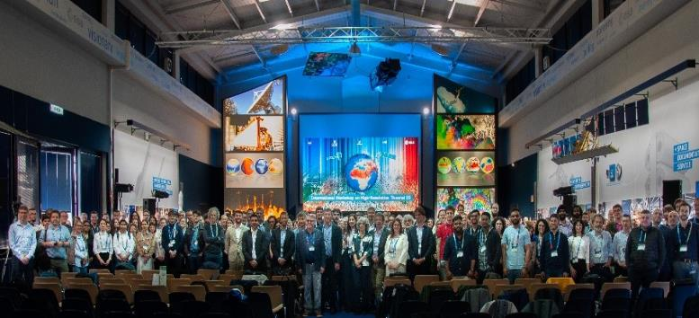
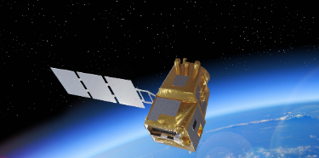








TRISHNA Mission overview
TRISHNA Mission design
ISRO/CNES cooperation, launch 2026
5-year lifetime
Design drivers: ecosystem stress and water use; coastal & inland waters
Global coverage land + coastal
3-day revisit, 60m ground resolution
Different observation angles, up to 38 deg
Overpass time : 12:30 PM & AM at Equator
VNIR-SWIR (7 bands) – LWIR (4 bands)
NeDT 0.2K at instrument output, AKA 0.5K
Free & open data policy
Level 1: top-of atm reflectances & brightness temp.
Level 2: ground and water reflectances, Land and Sea Surface temperature, Land Surface emissivities, vegetation variables, albedo, daily evapotranspiration
International collaboration (products, ATBDs, orbits, cal/val, campaigns)
International Workshop on High-resolution Thermal Infrared Earth Observation (ESRIN, May 2023)
LSTM
SBG
(Launch: 2029)
(Launch: 2028)
Land Surface Temperature Monitoring
Surface Biology and Geology
Spectral bands
0.5µm 0.6 0.7 0.8 0.9 1µm 1.1 1.2 1.3 1.4 1.5µm 1.6
8µm 9µm 10µm 11µm 12µm

Slide 18
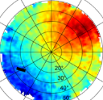
TRISHNA Mission overview
TRISHNA Mission design
ISRO/CNES cooperation, launch 2026
5-year lifetime
Design drivers: ecosystem stress and water use; coastal & inland waters
Global coverage land + coastal
3-day revisit, 60m ground resolution
Different observation angles, up to 38 deg
Overpass time : 12:30 PM & AM at Equator
VNIR-SWIR (7 bands) – LWIR (4 bands)
NeDT 0.2K at instrument output, AKA 0.5K
Free & open data policy
Level 1: top-of atm reflectances & brightness temp.
Level 2: ground and water reflectances, Land and Sea Surface temperature, Land Surface emissivities, vegetation variables, daily evapotranspiration
International collaboration (products, ATBDs, orbits, cal/val, campaigns)
Global coverage land + coastal
Average revisit (in days)
Spectral bands
0.5µm 0.6 0.7 0.8 0.9 1µm 1.1 1.2 1.3 1.4 1.5µm 1.6
8µm 9µm 10µm 11µm 12µm

Slide 19
Evapotranspiration
Evapotranspiration (ET) represents the largest water loss component of continental surfaces
→ key variable to rationalize the use of water for irrigated agriculture
Objective: deliver a continuous time series providing every day the best possible estimate of the field-scale daily evapotranspiration
ET also needed for: drought monitoring, weather and crop yield forecasting
→ TRISHNA inputs to compute ET: level 2A (LST, Emissivity) + level 2B (vegetation variables, albedo, fluxes)
ET (mm/day) 8 July 2008 from ASTER (resolution 100m)

Slide 20
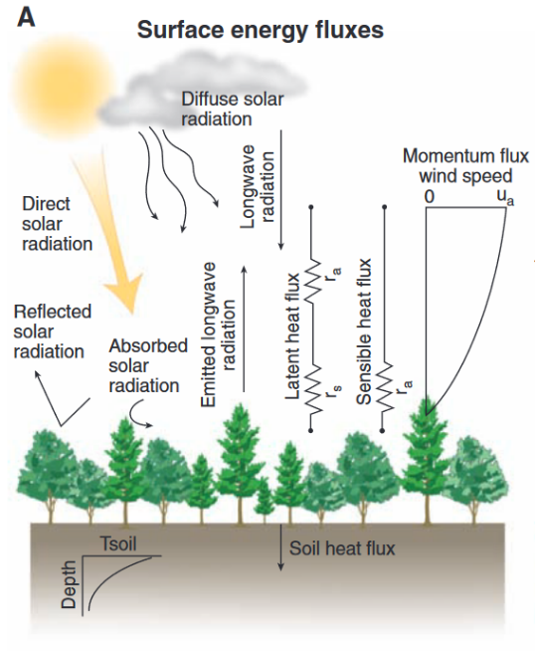


Radiative Transfer in the atmosphere and energy balance at the surface
Radiative transfer equation in the atmosphere: TRISHNA Level 1C to level 2A
Surface energy fluxes
L_{λ,TOA} = L↑ + [ρ_{λ}.L↓ + ε_{λ}.B (T)] x t_{λ}
λ
λ
λ
At-sensor Radiance
=
Radiance from the atmosphere
+
Radiance leaving the Earth surface
x
Atmospheric Transmission
LEVEL 1
Surface energy balance: TRISHNA Level 2B
Net Radiation
LEVEL 2
Rn(T) = Rg.(1 – a) + ε.Ra – ε.σ.T⁴
Rn(T) = H(T) + LE(T) + G(T)
Sensible Latent Ground
From Bonan, Science 2008
Evapotranspiration

Slide 21








Timeliness of evapotranspiration products
Detectable with VNIR
Water deficit
Stomatal
Closure to limit water losses
Healthy crop
Plant heating up
Reduced photosynthesis
Reduced dry matter production
Detectable with TIR
Water supply
Stomatal
Closure to limit water losses
Healthy crop
Plant heating up
Stomata
re-opening
Healthy crop
Satellite Acquisition
Level 3
Product

Slide 22
Summary / Takehome messages
Evapotranspiration represents the largest water loss component of continental surfaces
Daily field-scale time series of evapotranspiration are key to rationalize the use of water for irrigated agriculture
Evapotranspiration can be estimated as a residue of the surface energy balance equation, with land surface temperature as a major forcing variable
Timeliness is critical
Besides agriculture, many science and applications will benefit from high revisit & high resolution & high performance global surface temperature measurements
Challenges to deal with the thermal infrared signal: turbulence, directional anisotropy, pixel heterogeneity
Also technical challenges
Calibration & validation is challenging and will benefit from international synergies
TRISHNA is the frontrunner of this new generation of satellite missions
Contact: Philippe.Gamet@cnes.fr

Slide 23
Additional slides

Slide 24

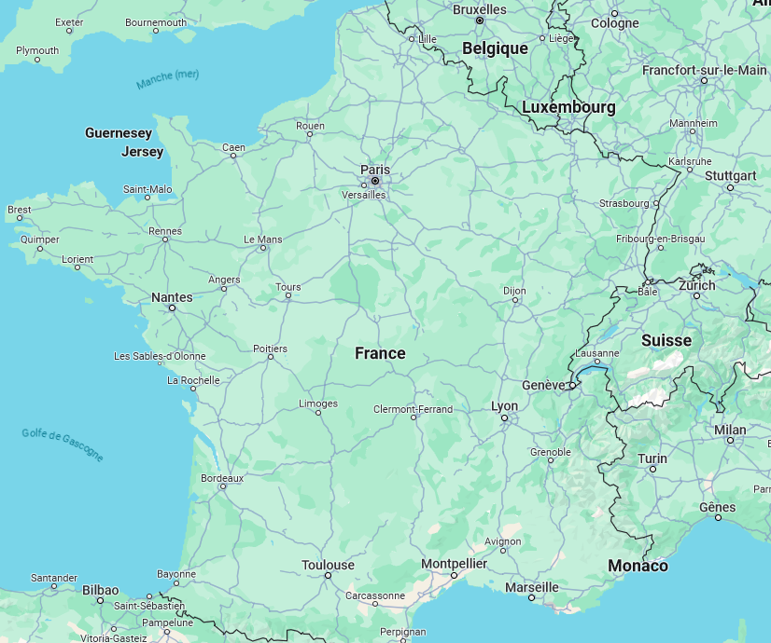
















































European Science institutes and public authorities involved
in the preparation of TRISHNA
European Science institutes and public authorities involved
in the preparation of TRISHNA
Supporting public authorities
Supporting universities
www.cnrs.fr
www.meteofrance.fr
www.cnes.fr
www.ofb.gouv.fr
www.ifremer.fr
www.inrae.fr
www.ird.fr
www.cerema.fr
www.uv.es www.uzh.ch

Slide 25
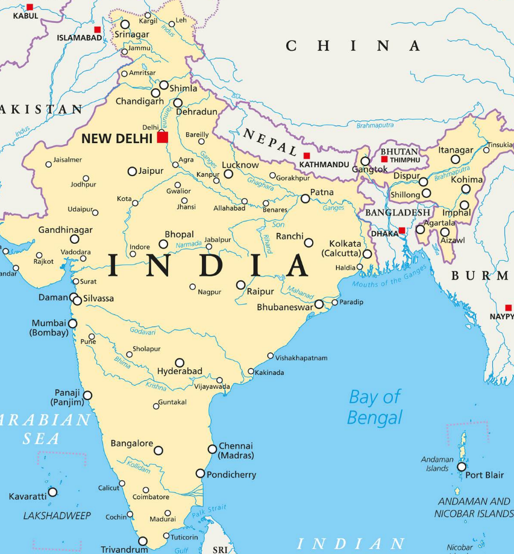








Indian Science institutes and public authorities involved
in the preparation of TRISHNA

Slide 26
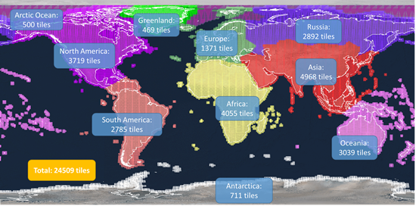
TRISHNA Production, timeliness and data distribution
TRISHNA Production, timeliness and data distribution
Building a continuous time series of daily evapotranspiration at field scale (level 3 product)
Indo-french workshare
  Production
  Cataloguing
  Cross-validation
Objective: products available 12h after acquisition for vegetation water stress detection and irrigation management
Preparing a multi-mission time series with TRISHNA, LSTM, SBG, …
80 000
36 M
14 PB
Distributed products per day
Generated products per year
Total storage for 7 years of data

Slide 27












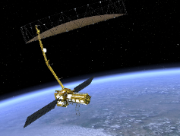

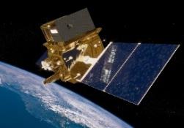







Earth Observation missions in synergy
Earth Observation missions in synergy
2029 & 2031
Land Surface Temperature Monitoring
Surface Biology and Geology
2025
2026
Dec 16, 2022
2028
Terrestrial Water Budget
Daily Evapotranspiration

Slide 28
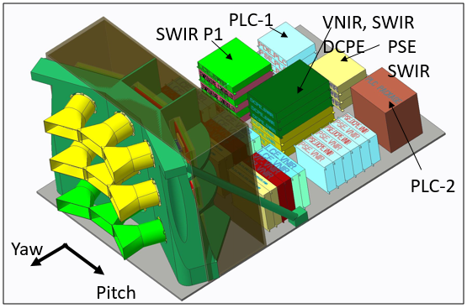
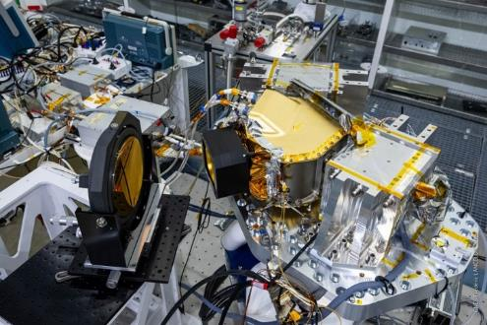
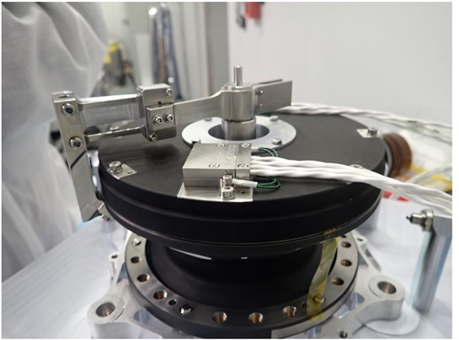
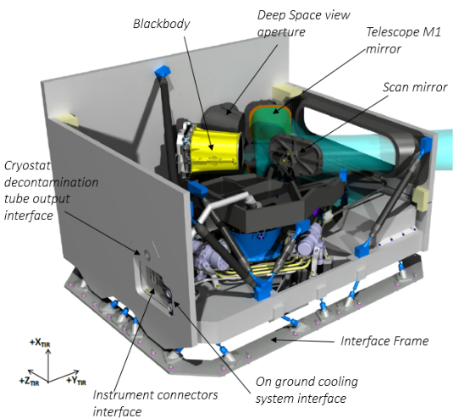
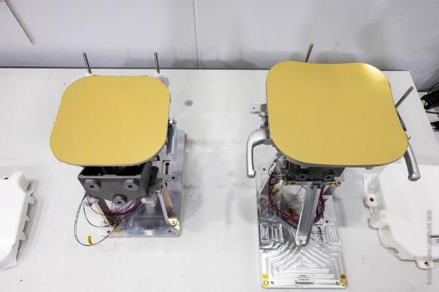

Building up the mission

Slide 29




Multiple partnerships

Slide 30








Preparing the mission on the ground (… and water, … and snow)
Malegaon vineyard site, Maharashtra (2021-)
Berambadi Flux Tower (2023-)
Coast HF station
Saildrone
Berambadi: 11 SM+TIR monitoring stations (2022-) + UAV (2024)
ECOSCOPA station
Waverider buoy

Slide 31
TRISHNA Science Products to applications
Level 1 products
Geocorrected & radiometrically corrected clear-pixel TOA - Reflectances & Brightness temperatures
Atmospheric
correction
^{(*)} Under study, actual production to be confirmed
Level 2A products
Surface temperature
Surface emissivities
Surface reflectances
Atmospheric variables (AOD, water vapour)
Cloud mask
Retrieval & Energy balance solutions
Level 2B land products
Vegetation variables
Radiation fluxes
Evaporation fluxes
Primary productivity ^{(*)}
Assimilation to process & AI models
Level 3 Products
Continuous all-sky evapotranspiration
Stress & productivity variables ^{(*)}
Ecosystem stress &
water use
Downstream applications
Level 2B water products ^{(*)}
Water quality
Water color
Coastal & Inland waters
Assimilation to process models
Urban microclimate
Cryosphere
Solid Earth

Slide 32


Surface energy balance with TRISHNA inputs
Surface energy balance
Net Radiation
LEVEL 2
Rn(T) = Rg.(1 – a) + ε.Ra – ε.σ.T⁴
Rn(T) = H(T) + LE(T) + G(T)
Sensible Latent Ground

